Slide 1
Adult Income Census
Adam Benko, Peter Chen, Seunggyun Shin,
_{Courteney Chan, Jennie Hsu}

Slide 2
01
02
03
Introduction
Data
Understanding
Research
Questions
04
04
05
Data
Pre-processing
Modeling &
Analysis
Conclusion

Slide 3

01 Project
introduction
Data
• Kaggle Adult Income Census Data (31,947 rows * 12 columns)
- https://www.kaggle.com/datasets/anaghakp/adult-income-census?resource=download
Background
• The dataset includes demographic features, and for each observation, it indicates whether the income exceeds 50K or not
• Important to observe social tendencies and identify inequalities
• Utilized in economic forecasting and workforce planning
Objective:
• Deliver insights corresponding with the research questions through visualizations and determine features that influence income level
3

Slide 4

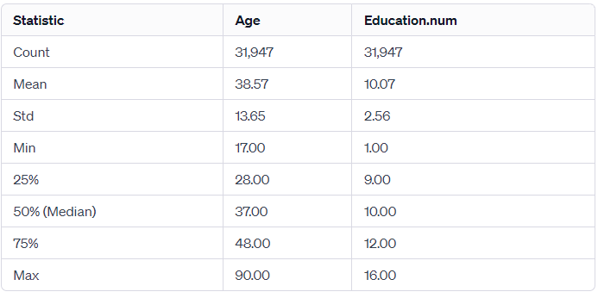
02 Data
Understanding
• Observe data through Tableau visualizations to extract interesting research questions

Slide 5
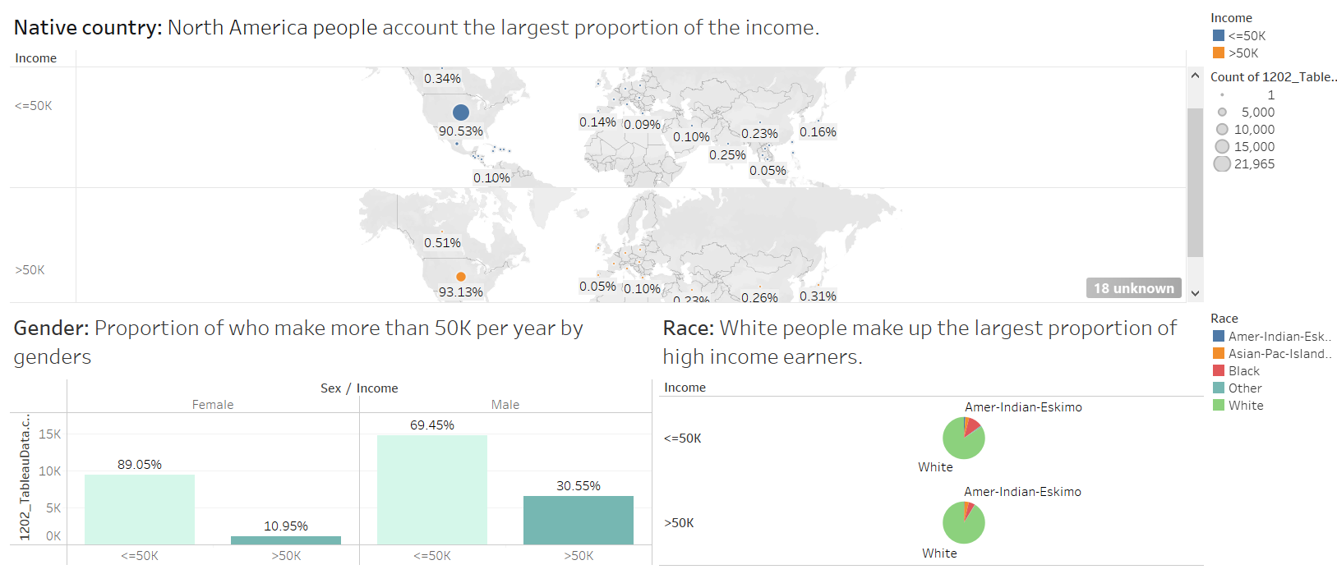
Story Point 1
5

Slide 6
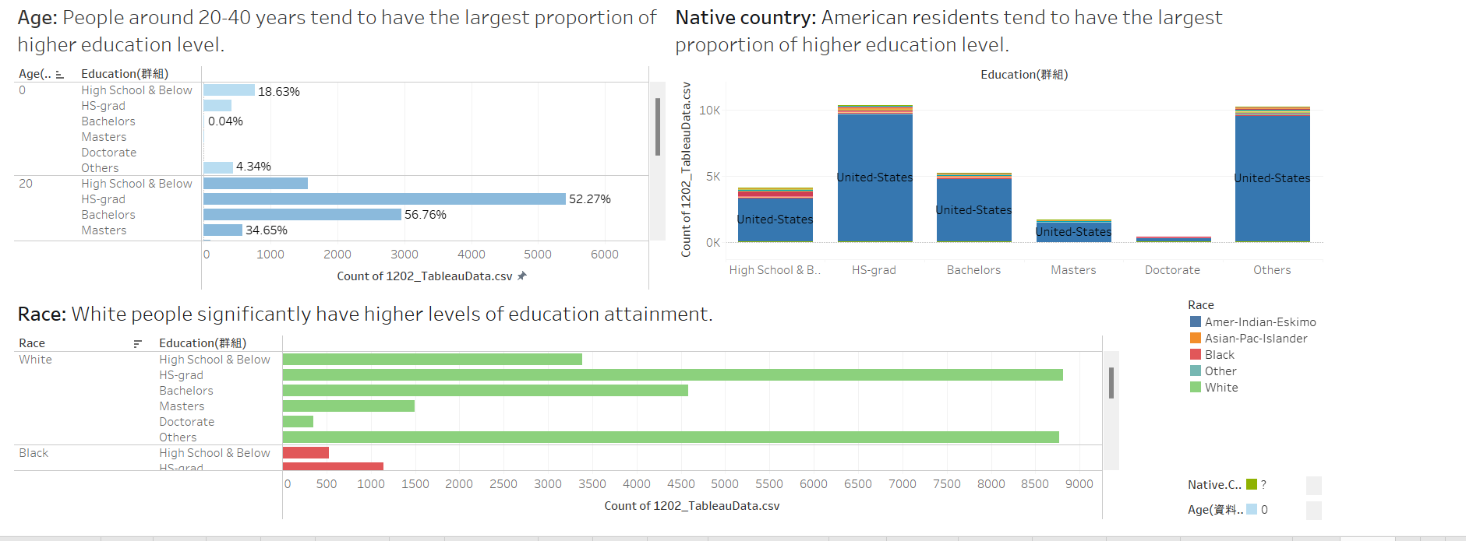
Story Point 2
6

Slide 7

03 Research questions
Key Questions
Research Q1
Is there significant differences in income between gender, and is difference in education level causing the gap of income?
Research Q2
Which factors contribute the most to income/ help us understand where income inequality stems from?

Slide 8

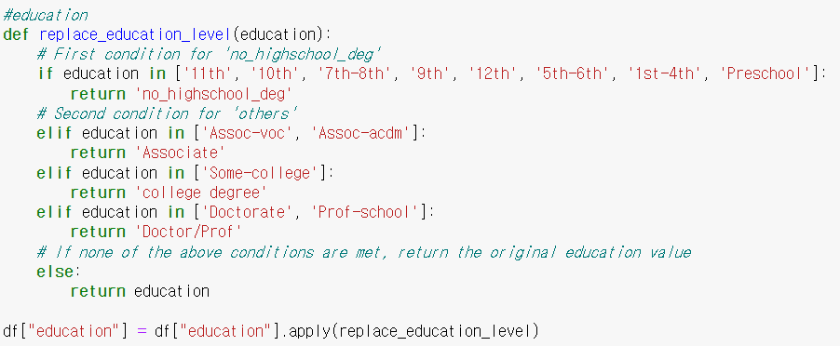
04 Data Pre-processing
• Prepare Data for Modeling
1. Drop NA values (6% data loss)
3. Drop Columns & Create Dummies (Before modeling)
2. Adjust column values: education, marital.status
- Reduce dummy variables by observing group means
- Income: Response variable
- Relationship: Correlated w/ Marital Status
- Education: Correlated w/ Education Number
- Occupation: Correlated w/ Workclass
- Native Country: Biased towards the “United States”

Slide 9
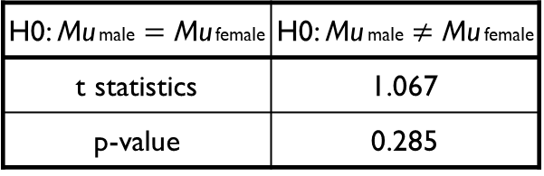
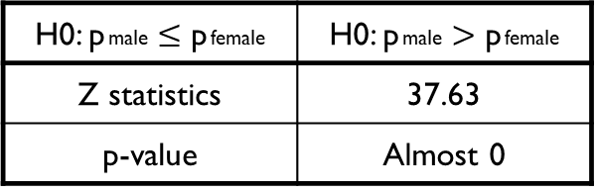
05 Modeling &Analysis
• Research Question 1
- Is there significant differences in income between gender, and is difference in education level causing the gap of income?
1. Income by Gender
2. Education by Gender
- One-tailed z-test for proportions (α = 0.05)
- p: Proportion of who earn more than 50K
- Two-tailed two sample t-test
- Mu: Mean of education numbers
H0: p male $≤$ p female | H0: p male $>$ p female
Z statistics | 37.63
p-value | Almost 0
H0: Mu male $=$ Mu female | H0: Mu male $≠$ Mu female
t statistics | 1.067
p-value | 0.285
- There is a significant evidence that male earns more money than female does. However, as there is no evidence to claim that there is a difference in education level between two genders, education level is not a factor which causes the difference.

Slide 10
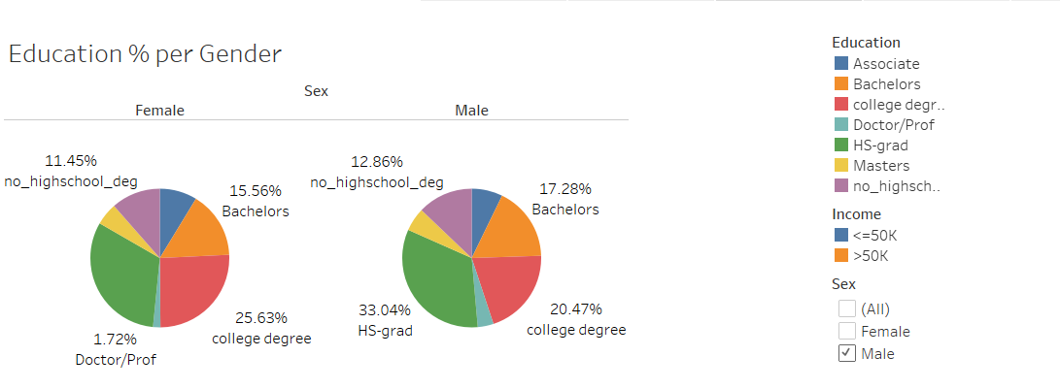
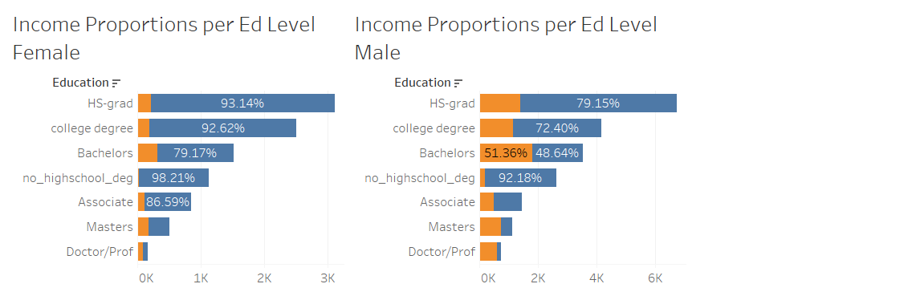
Story Point 3

Slide 11
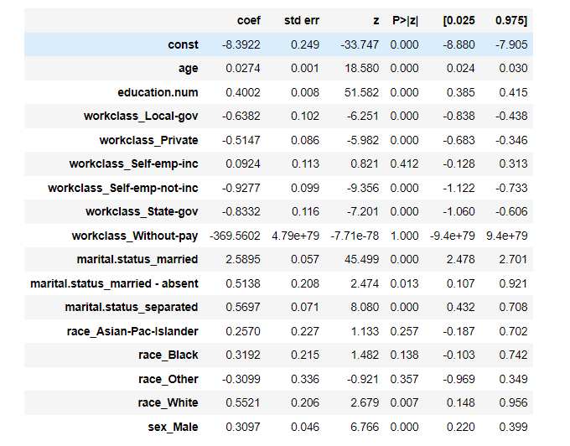
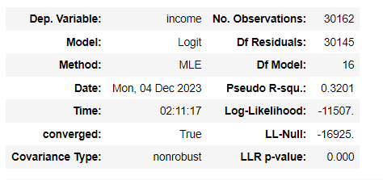
05 Modeling &Analysis
• Research Question I1
- Which factors contribute the most to income/ help us understand where income inequality stems from?
- Selected models with high explainability
1. Logistic Regression
- 82% fitted accuracy (Threshold: 0.5)
- Age, Education, Marital Status

Slide 12
05 Modeling &Analysis
Logistic Regression Model Findings:
Significant Predictors: by p-values less than 0.05
Education: Important for income level, but not gender
Marital status (Married): Married females tend to earn more
Sex: Men are more likely to earn >50k more than women

Slide 13
05 RESEARCH findings
Logistic Regression Model Findings:
Model Statistics:
pseudo-R-squared value: 0.3201: 32% of the variability in the income is explained by the model
The LLR p-value: close to 0
statistically significant when compared to a null model with no predictors

Slide 14
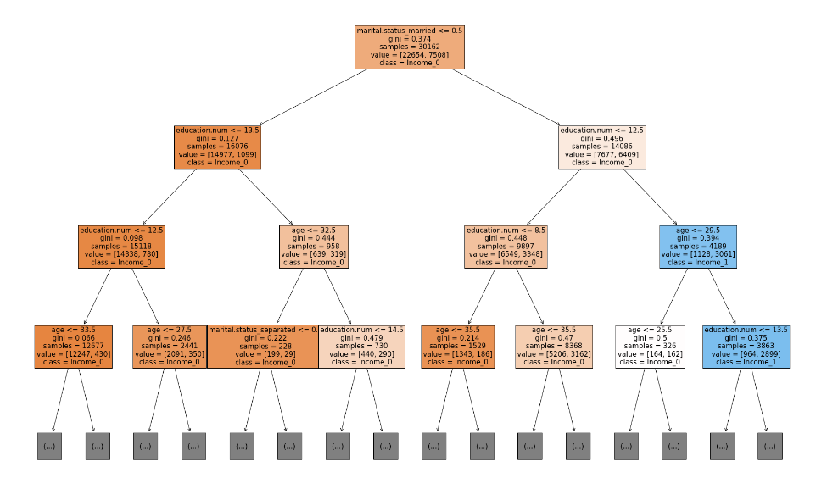
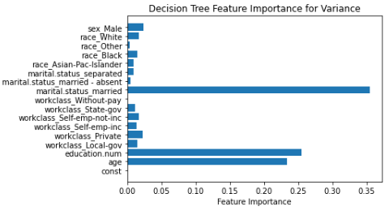
05 Modeling &Analysis
• Research Question I1
- Which factors contribute the most to income/ help us understand where income inequality stems from?
1. Decision Tree Classifier
- 87% fitted accuracy
- Age, Education, Marital Status
12

Slide 15
05 RESEARCH findings
Decision Tree Model Findings:
Primary Splits: the number of education years and marital status
Thresholds for Splits:
Education: <= 13.5 years and <= 12.5
Age: <= 29.5 years, <= 33.5 years, and <= 35.5 years, etc.
Sample Sizes and Class Predictions: Each node provides sample sizes and the class prediction (income 0 or income 1) for the data points that fall into that node, based on the splits made by the tree.

Slide 16
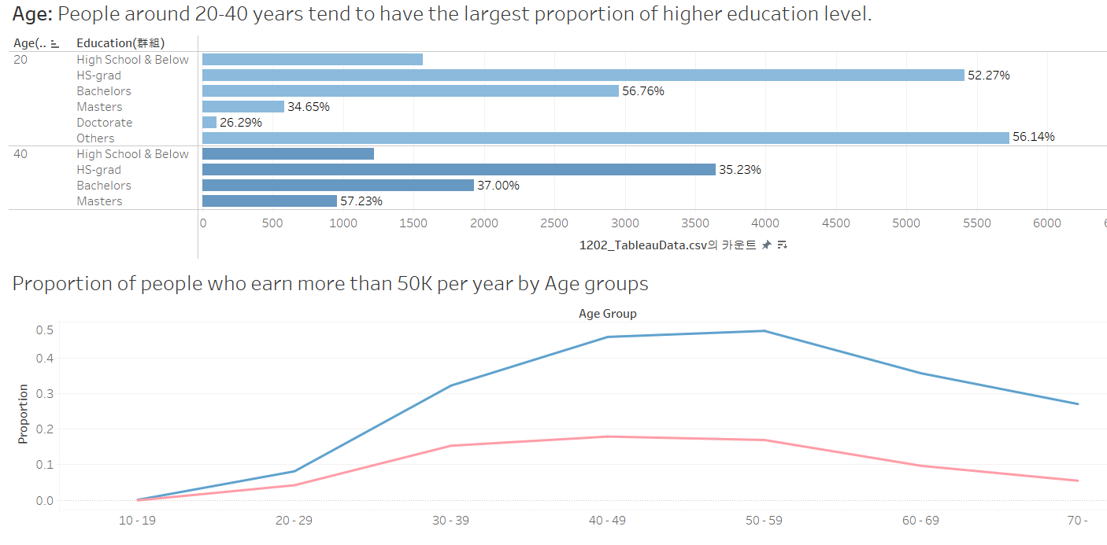
Story Point 4

Slide 17
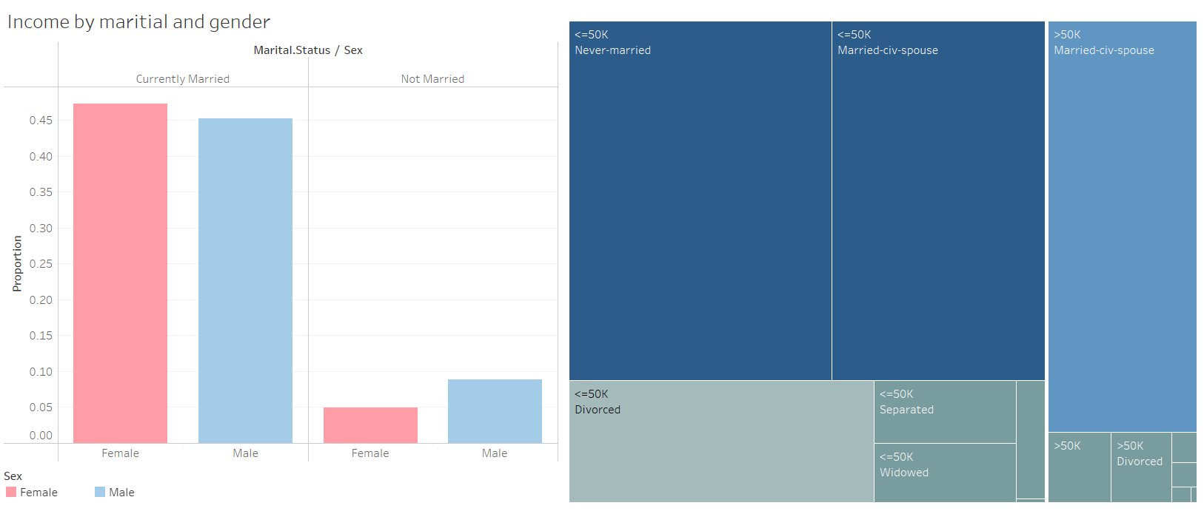
Story Point 5
14

Slide 18

06 Project
Conclusion
Summary
• There is a sufficient difference in income level by genders.
• Education level, age, and marital status are significant variables that has notable relationships with income level. However, they are not a factor causing income gap between genders.
Improvements
• The dataset is biased that there can be more reliable result with a better dataset.
ex) Married proportion of female <<<< proportion of male
• The variable “fnlwgt”, describes the weight of each row, can be utilized for more accurate analysis.
18
15

